Slide 1




Data Element Library (DEL) Search Re-Design
A faster way to get to the information you need.

Slide 2

Agenda
Current State of the DEL
Feedback that prompted change
Demonstration of proposed change
Feedback and open Q&A

Slide 3
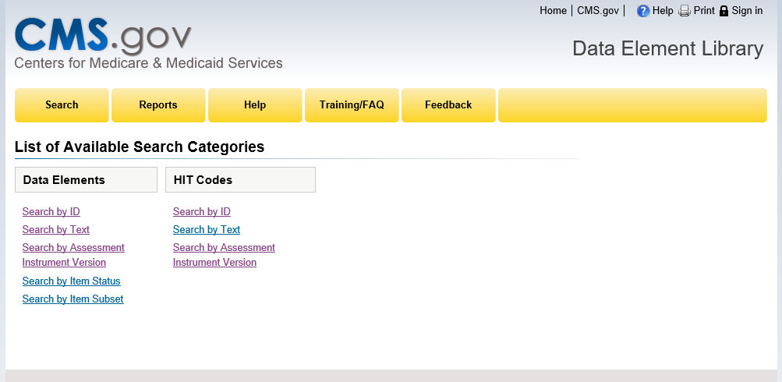
The Current State

Slide 4

Case for Change
“Put the date the version of the tool went into effect with the version number. It would make it easier to isolate the accessible data in specific instances.”
“Not user friendly with all the links.”
“Unable to drill down in results list without choosing a new link.”
Feedback from users of the DEL

Slide 5

New Search Demo

Slide 6

Requested Feedback
Drill down on the left side or at the top?
Default results list to start?
When results table shows, would you like the drill down area shortened to get more real estate for the table?
Are there other items you would like to narrow your search by?
Would you find the ability to export your list of results from the search page helpful?
Q&A

Slide 7


Send Feedback by 01/31 to
del-Support@nicwdm2.com

